Slide 1
Agile Estimation Workshop
AgileChina 2015
July 13, 2015
Stephen Vance

Slide 2

Who Am I?
Pre-Manifesto Agilist
Director of Agile at Zipcar
Author
Software Craftsman
Traveler
Senior Pet Care Engineer

Slide 3
Agenda
Morning 9a-12p
Afternoon 2p-5p
Opinion-based Estimation
Estimation Overview
Absolute Opinions
Relative Opinions
Story Points
Consensus-based Estimation
Story Point Velocity
Team Strength
Visualization
Other Opinions
Confidence Factors
Empirical Estimation
Cycle Time
Queuing Theory
Velocity
Statistics
Drawing Conclusions
Cycle Time Forecasting
Bayesian Inference
Monte Carlo Simulation
Subjectivity in Estimation

Slide 4
Opinion-based Estimation
Morning

Slide 5
The 3 Project Management Questions
 | Question | Known As
1 | How much work can we do in a certain amount of time? | Capacity planning
2 | How long will it take to finish a certain amount of work? | Delivery forecasting
3 | How close are we to delivering against our forecast? | Progress reporting
Notes:
Let’s look at estimation, for example. Estimation answers three basic questions.
We commonly use Planning Poker to estimate stories. You generally estimate stories as the last step to make them ready to work on. The Agile Manifesto tells us to “maximize the amount of work not done” and to embrace change. Together those tell us to refine and estimate as few stories as we can to achieve our goals because priorities will change. We need to estimate stories for the next sprint, addressing capacity planning (question 1). Minimizing the investment does not provide longer term delivery forecasts (question 2) or delivery progress (question 3).
This implies that Planning Poker and story points only help to perform capacity planning. Although capacity planning may be useful, does it justify the practice? What else does Planning Poker do?
Planning Poker urges teams to have meaningful and thorough conversations to understand the work. It does this through the application of a familiar practice, but with an entirely different primary benefit. However, that means that if the practice focuses more on producing a number than stimulating the right conversation about the work, much of the benefit is lost. We retain the benefit through understanding the practice more deeply.
Deeper understanding also helps us realize that lighter-weight techniques, such as t-shirt sizing and empirical forecasting, are more appropriate for longer time frames. We don’t want to break down months of work into estimable stories if we assume that needs and priorities will change.

Slide 6
The 3 Project Management Questions
 | Question | Known As
1 | How much work can we do in a certain amount of time? | Capacity planning
2 | How long will it take to finish a certain amount of work? | Delivery forecasting
3 | How close are we to delivering against our forecast? | Progress reporting
 | Question | Known As
1 | How much can we do next sprint? 下个迭代我们能做多少？ | Capacity planning 产能计划
2 | How long will it take to do the project? 做这个项目要多长？ | Delivery forecasting 交付预测
3 | How is our progress? 我们的进度如何？ | Progress reporting 进度汇报
Notes:
Let’s look at estimation, for example. Estimation answers three basic questions.
We commonly use Planning Poker to estimate stories. You generally estimate stories as the last step to make them ready to work on. The Agile Manifesto tells us to “maximize the amount of work not done” and to embrace change. Together those tell us to refine and estimate as few stories as we can to achieve our goals because priorities will change. We need to estimate stories for the next sprint, addressing capacity planning (question 1). Minimizing the investment does not provide longer term delivery forecasts (question 2) or delivery progress (question 3).
This implies that Planning Poker and story points only help to perform capacity planning. Although capacity planning may be useful, does it justify the practice? What else does Planning Poker do?
Planning Poker urges teams to have meaningful and thorough conversations to understand the work. It does this through the application of a familiar practice, but with an entirely different primary benefit. However, that means that if the practice focuses more on producing a number than stimulating the right conversation about the work, much of the benefit is lost. We retain the benefit through understanding the practice more deeply.
Deeper understanding also helps us realize that lighter-weight techniques, such as t-shirt sizing and empirical forecasting, are more appropriate for longer time frames. We don’t want to break down months of work into estimable stories if we assume that needs and priorities will change.

Slide 7

Valid Reasons for “Target Dates”
Regulatory compliance dates
Holidays
Advertising buys
Heavy manufacturing purchases
Cars
Airplanes
Robots
Market expectations
Customer commitments
Contractual obligations
Notes:
Don’t get me wrong. There are valid or unavoidable reasons for deadlines, such as regulatory compliance dates and holidays, and a number of processes to coordinate with that have not-as-Agile lead times, like advertising buys and heavy manufacturing.
Many dates are purely aspirational. Maybe we want to be ready in time for a seasonal fluctuation or just want to get it done as fast as possible.

Slide 8

How Long Will It Take?
Opinions
Measurements
Models
Forecasts
Notes:
“Estimates” is very overloaded
It’s more important how they were obtained than the form they take
A number by itself doesn’t tell that story, but can look authoritative anyway
Know what you are estimating, e.g. size, time, complexity, effort

Slide 9

Opinions
Human-generated values
Also known as
Guesses
Guestimates
Educated guesses
SWAGs
Estimates
2
3
4½
8

Slide 10
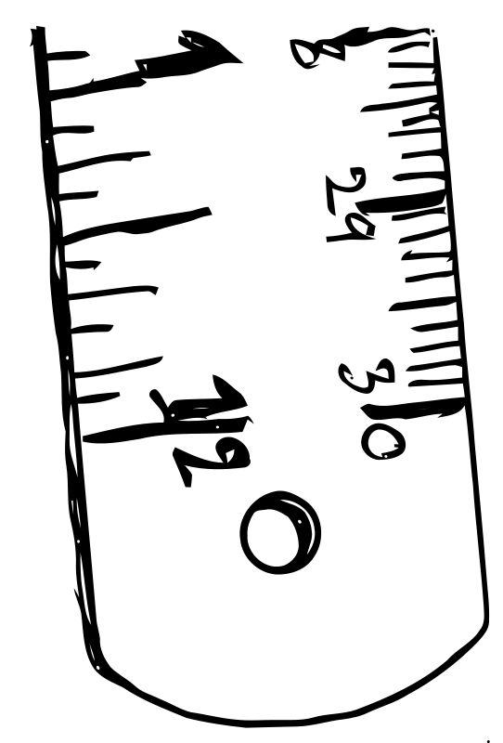
Measurements
Observed, empirical values
Also known as
Observations
Assessments
Estimates

Slide 11
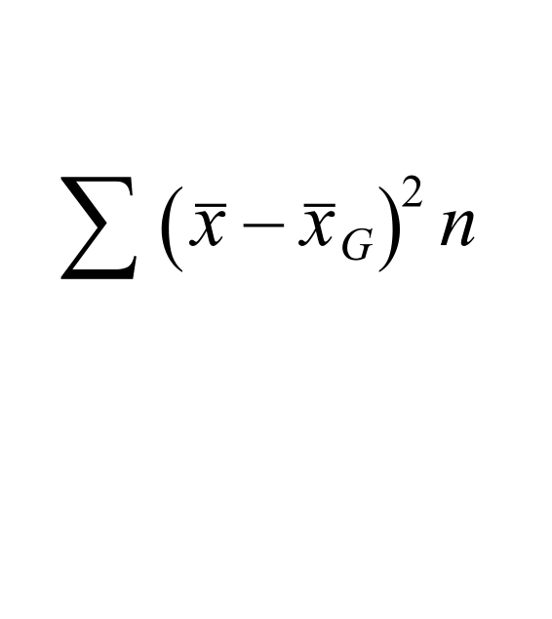
Models
Description of behavior
Often mathematical
Also known as
Equations
Frameworks
Behaviors
Graphs

Slide 12

Forecasts
Statements about the future from applying models to opinions and measurements
Also known as
Predictions
Estimates

Slide 13
Classification Game
Notes:
Instructions:
Take the deck of index cards labelled “Classification.” The top four cards give you categories of Opinion, Measurement, Model, and Forecast. Put them in different areas of your table. For each of the other cards, determine as a group which category each card fits in. Take notes on the cards that are difficult to categorize and why. Take 10 minutes.
Discussion (5 min): Which items were hard to classify? Who else had trouble classifying that item? Why? What did you discuss?
Wrap-up Instructions: Collect the cards

Slide 14
Absolute Opinions
Opinion-Based Estimation

Slide 15

Time
Opinion
Examples
Hours
Days
Real days

Slide 16
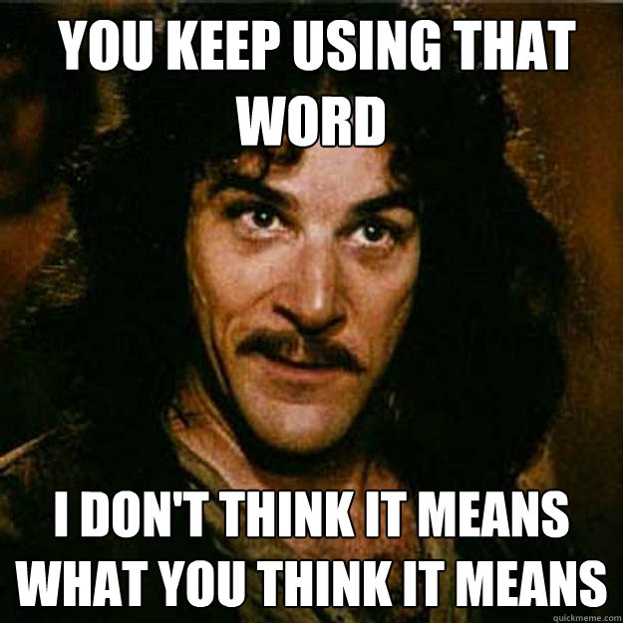
Problems With Time
Seems like familiar units
… but isn’t
Duration or effort?
The longer the period, the worse we are at estimating it

Slide 17
Relative Opinions
Opinion-Based Estimation

Slide 18

Relative Sizing
Opinion
“Relative” is essential!

Slide 19
Why Relative Sizing Works
Points
5
1
3
2
1 Sprint

Slide 20
Problems With Relative Sizing
Only valid across short time intervals
References get stale
Capabilities change
Only applies from point at which opinion is rendered
You can’t compare different
Teams
Problem domains
Skills
Technologies

Slide 21
Relative Sizing Game
Notes:
Instructions:
Take the deck of cards labelled “Relative Sizing.” The goal is to arrange the cards on your table from smallest to largest. The first person should take the first two cards and arrange them so that one is larger than the other. The next person should place the next card relative to the first two. Rotate around the group, place all cards until you have them arranged. Take notes on the activities that are hard to size, which activities you compared them with, and what are the challenges. You have 5 minutes.
Discussion (10 min): What definition of “size” did you use? Were you able to arrange all the cards? Were some cards harder to place than others? What comparisons gave you trouble? Why did they give you trouble?
Wrap-up Instructions: Leave the cards on the table for the next game.

Slide 22
Story Points
Opinion-Based Estimation

Slide 23

Story Points
Don’t normalize!
If it uses story point as a unit, don’t compare it
Be careful with story point math
Story points aren’t precise
Larger values have higher uncertainty
Notes:
Catalyst for the right conversation about the work

Slide 24
Story Point Values
Fibonacci-like
0, ½, 1, 2, 3, 5, 8, 13, 20, 40, 100, ∞, ?
Powers of 2
0, 1, 2, 4, 8, 16, 32, 64, ∞, ?

Slide 25
But What Are Story Points?
Duration
Size
Complexity
Risk
Repetition
Effort
Function Points

Slide 26
Consensus-Based Estimation
Opinion-Based Estimation

Slide 27
What Is Consensus?
General agreement
Many thresholds of agreement
Majority
Plurality
Unanimous
Many ways to reach agreement
Decision Rules
Consensus
Delegation
Decision Leader Decides Without Discussion
Negotiation
Majority Vote
Spontaneous Agreement
Arbitrary
Decision Leader Decides After Discussion

Slide 28
Why Consensus?
Produces a number
Stimulates conversation about the work
Facilitates common understanding of the work

Slide 29
Planning Poker
Team discusses and refines user story
Team secretly votes on story point value
Team reveals user story value
Team discusses differences
Agreement?
No
Yes
Assign story point value to story

Slide 30
Planning Poker Game
Notes:
Instructions:
Choose reference stories (3 min)
Decide which activity or two you want to represent 1 point. Choose 1-2 activities that are about twice that size to be your 2 point reference stories. Choose 1-2 activities that are about three times the size of your 1 point reference story to be your 3 point stories. Write the story point size on the card.
Size the remaining activities (12 min)
You don’t have to estimate all of the activities. Try to estimate a few. Start by discussing your understanding of the activity. You will find things that are not well defined or that you disagree on how you see them. Decide how you’ll interpret differences of opinion to estimate against. Vote on the points for a story relative to your reference stories. If you agree, write that number and move to the next story. If you disagree, talk about why and revote until you agree on a size. Do as many stories as you can in the allotted time. Use fingers, apps, or cards to vote.
Discussion: Who deliberately chose to start with smaller activities to estimate? Who deliberately increased the size of the activities? Did you agree on sizes quickly? If not, which activities were difficult and why?
Wrap-up Instructions: Collect the cards

Slide 31
Story Point Velocity
Opinion-Based Estimation

Slide 32
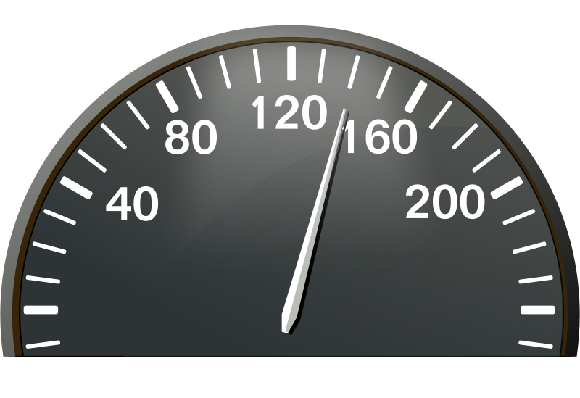
Story Point Velocity
Story Points/Sprint
Useful for predicting near-term capacity
Any other use should be handled with care

Slide 33
Using Velocity
Capacity Planning
Sliding average
Story size
Variation
Longer-term forecasting
Refining and estimating stories too far in advance can be wasteful

Slide 34
Abuses of Velocity
Evaluating productivity
Evaluating process improvement
Except at the coarsest level
“After two consecutive sprints at 0 velocity we’ve managed to get to a consistent velocity of more than 20 for several sprints now!”
Evaluating individuals
Predicting individual task completion
Forecasting precisely
Notes:
Velocity proxies work, not value
Lots of team variables contribute to velocity
Smaller stories have more consistency
Improvements in actual productivity
Reductions in rework
Velocities are aggregate measures, and the aggregates don’t represent individuals
Individual people and work items are susceptible to higher variability
Ironically, statistics work in your favor to make longer forecasts more precise, at least proportionately

Slide 35
Team Strength
Opinion-Based Estimation

Slide 36
Team Strength
Event | People | Days | Total
Nominal | 5 | 10 | 50
Joe Vacation | 1 | 5 | -5
Team Training | 5 | .5 | -2.5
Holiday | 5 | 1 | -5
Sub-Total |  |  | 37.5
Strength Coefficient |  |  | .75

Slide 37
Applying Team Strength
Sprint | Predicted Strength | Strength Coefficient | Points Completed | Effective Velocity | Rolling Average | Predicted Capacity
 | Opinion | Predicted/ Nominal | Observation | Completed/ Coefficient | 3 Sprints | Rolling * Coefficient
7 | 30 | .75 | 15 | 20
8 | 40 | 1.00 | 20 | 20 | 20 | 20
9 | 35 | .88 | 15 | 17 | 20 | 18
10 | 40 | 1.00 | 16 | 16 | 19 | 19
11 | 20 | .50 |  |  | 18 | 9
https://github.com/srvance/AgileEstimation
Notes:
Harder to apply to cycle time and somewhat defeats the purpose

Slide 38
Team Strength Example
Notes:
Pick four people from the audience and get them to be creative about their upcoming strength and vacation.

Slide 39
Visualization
Opinion-Based Estimation

Slide 40
Burn Down Chart

Slide 41
Burn Up Chart

Slide 42
Other Opinions
Opinion-Based Estimation

Slide 43

T-shirt Sizes
“Buckets”
Comparing adjacent sizes
Prevents sizing math
For better and worse
Great for epics!

Slide 44

Relative Mass Sizing
Arrange by size
Group by similar size
Notes:
http://www.sitepoint.com/3-powerful-estimation-techniques-for-agile-teams/

Slide 45
Confidence Factors
Opinion-Based Estimation

Slide 46
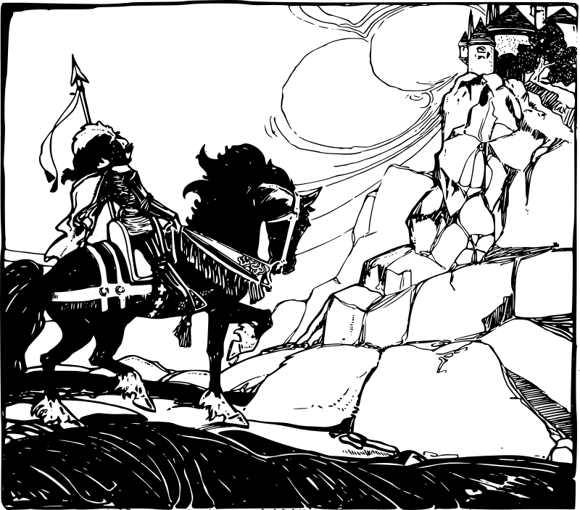
Confidence Factors
More focused version of traditional management “tool”
Makes risk assumptions explicit
Separates estimation of the work from estimation of the risk

Slide 47
Using Confidence Factors
Ask for the opinion as
50% likelihood opinion
Reasonable happy case
Vote on a confidence factor
1 Completely
2 Sort of
3 Not at all

Slide 48
Confidence Factor Example
Without Confidence Factors
With Confidence Factors
Story | Estimate
A | 1
B | 2
C | 8
D | 13
E | 5
F | 3
G | 1
H | 8
Total | 41
Story | Happy | Confidence | Adjusted
A | 1 | 1 | 1=
B | 1 | 2 | 2=
C | 2 | 3 | 6<
D | 5 | 2 | 10<
E | 2 | 2 | 4<
F | 3 | 1 | 3=
G | 1 | 1 | 1=
H | 5 | 2 | 10>
Total | 20 |  | 37

Slide 49
Empirical Estimation
Afternoon

Slide 50
Cycle Time
Empirical Estimation

Slide 51
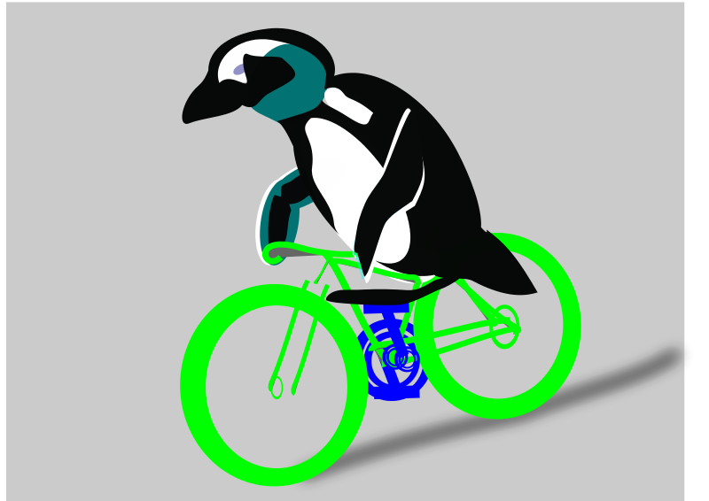
Cycle Time
Measurement
Applies when work is identified
Applies across subsets of the process
Normalizes for roll up forecasts
Don’t use for individual team comparisons

Slide 52

Cycle Time Story Time
Story Points | Cycle Time (days)
1 | 15
2 | 18
3 | 20
5 | 17
5X spread fits in 17.5±2.5 days:
±14% by assuming stories
are all the same size!

Slide 53
Some Example Cycle Times
Team | Description | Cycle Time | Standard Deviation
A | Figuring out Agile on their own and just got a coach | 18 days | 12 days
B | Strong coaching, early on, complex technology | 4.5 days | 3 days
C | Strong coaching, mature, complex technology | 2 days | 1.2 days
D | Strong coaching, mature, well understood technology | 12 hours | 4 hours

Slide 54
Queuing Theory
Empirical Estimation

Slide 55

Little’s Law 利特尔法则
“The long-term average number of customers in a stable system L is equal to the long-term average effective arrival rate, λ, multiplied by the (Palm‑)average time a customer spends in the system, W; or expressed algebraically: L = λW.”
λ=L/W is a formulation of velocity

Slide 56
Translation
Throughput = WIP / Cycle Time
生产率＝在制品个数／生产周期
Notes:
What is WIP?
WIP as the lever you can adjust
Heuristics for setting WIP

Slide 57
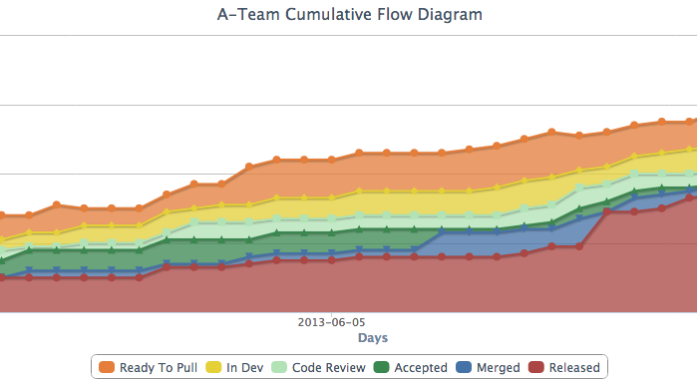
Cumulative Flow Diagrams (CFDs)
Throughput
WIP
Cycle Time
https://github.com/wrackzone/kanban-cumulative-flow-chart

Slide 58
Predictive vs. Analytical Use
Throughput
WIP
Cycle Time
https://github.com/wrackzone/kanban-cumulative-flow-chart

Slide 59
The “Same Size” Misconception
Notes:
Useful as a verbal shorthand, but easy to take literally
Roughly the same average size is all that Little’s Law requires
Strictly alternating 1- and 14-day tasks meet the criteria for any 15-day period

Slide 60
Am I Ready For Cycle Time?
Week | Cycle Time | 2-week | 3-week | 4-week | 5-week | 6-week
1 | 5
2 | 0 | 2.5
3 | 10 | 5.0 | 5.0
4 | 0 | 5.0 | 3.3 | 3.8
5 | 0 | 0.0 | 3.3 | 2.5 | 3.0
6 | 15 | 7.5 | 5.0 | 6.3 | 5.0 | 5.0
7 | 5 | 10.0 | 6.7 | 5.0 | 6.0 | 5.0
8 | 0 | 2.5 | 6.7 | 5.0 | 4.0 | 5.0
9 | 10 | 5.0 | 5.0 | 7.5 | 6.0 | 5.0
10 | 0 | 5.0 | 3.3 | 3.8 | 6.0 | 5.0
11 | 0 | 0.0 | 3.3 | 2.5 | 3.0 | 5.0
12 | 15 | 7.5 | 5.0 | 6.3 | 5.0 | 5.0
Spread | 15.0 | 10.0 | 3.3 | 5.0 | 3.0 | 0.0
Std Dev | 6.3 | 3.1 | 1.3 | 1.7 | 1.3 | 0.0
Notes:
People often ask, “How do I know my stories are small enough to meet the conditions for cycle time?”
Instead ask, “What’s the smallest window of time over which the conditions hold?”
Rather than trying to figure out whether your stories are small enough to meet the “average size” condition, flip the reasoning and use the variance in your cycle time to determine the smallest meaningful time window about which you can report.
If that’s not small enough for what you want, you now have a source of and motivation for measurable process improvement.
These are the mathematical preconditions for moving to cycle time. Discuss process preconditions.

Slide 61
Velocity
Empirical Estimation

Slide 62
Common Velocity Model
Velocity = S/P/D
S is Size, e.g. story points, items
P is unit of Production, e.g. team, person, unit team strength
D is Duration, e.g. sprint, day, week
Valid across estimation types
Scrum
Points/team/sprint
Cycle time
Items/system/unit time

Slide 63
Statistics
Empirical Estimation

Slide 64
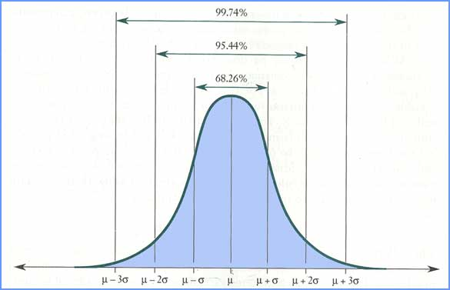
Normal Distributions

Slide 65
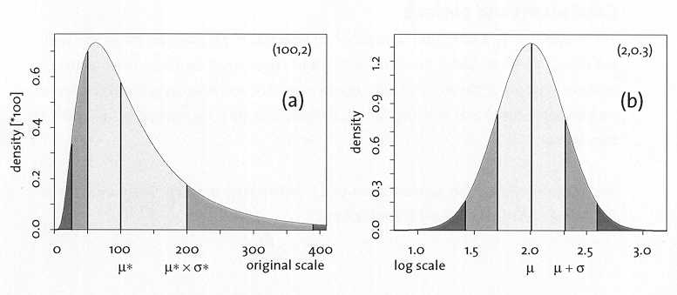
Log-Normal Distribution

Slide 66
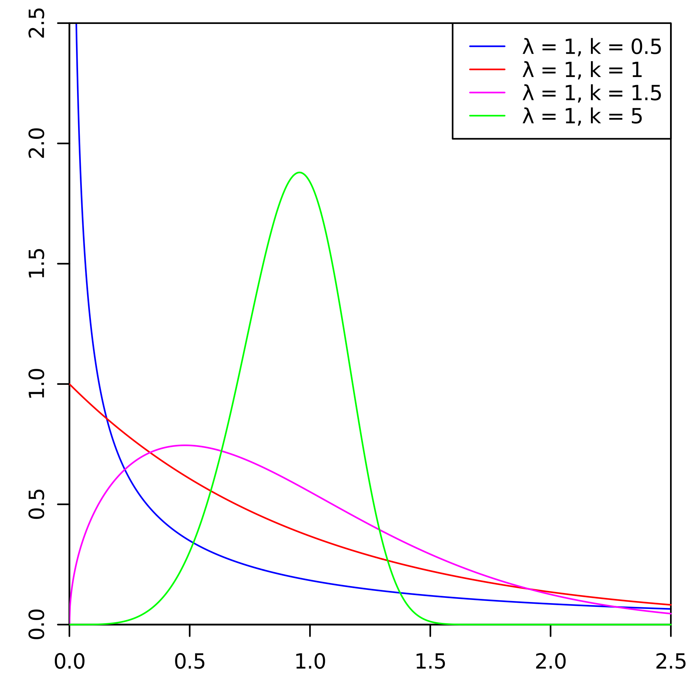
Weibull Distribution
https://commons.wikimedia.org/wiki/File:Weibull_PDF.svg

Slide 67
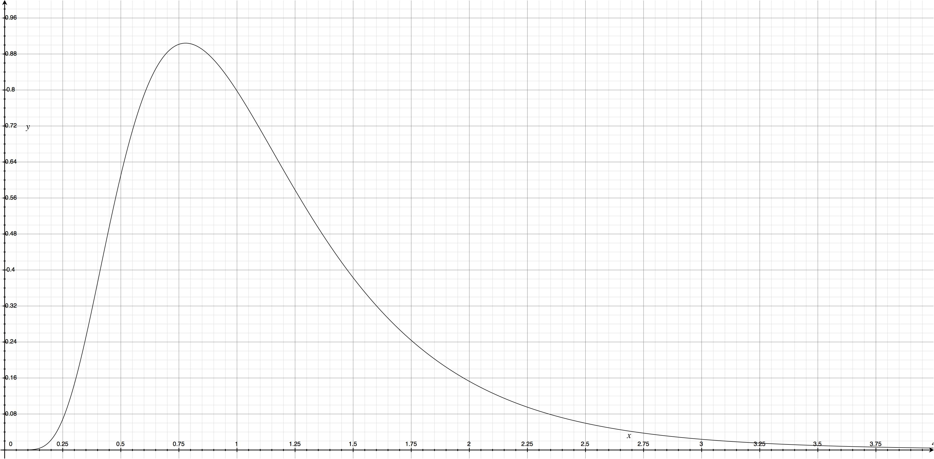
Instantaneous Completion Likelihood
Notes:
Probability density function
Asymmetric curve
Non-asymptotic on left
Theoretically asymptotic on right
Derivative of cumulative distribution
Sometimes modeled with log-normal or Weibull
Note that log-normal is the resulting curve from a Markov distribution of completion times per queueing theory

Slide 68
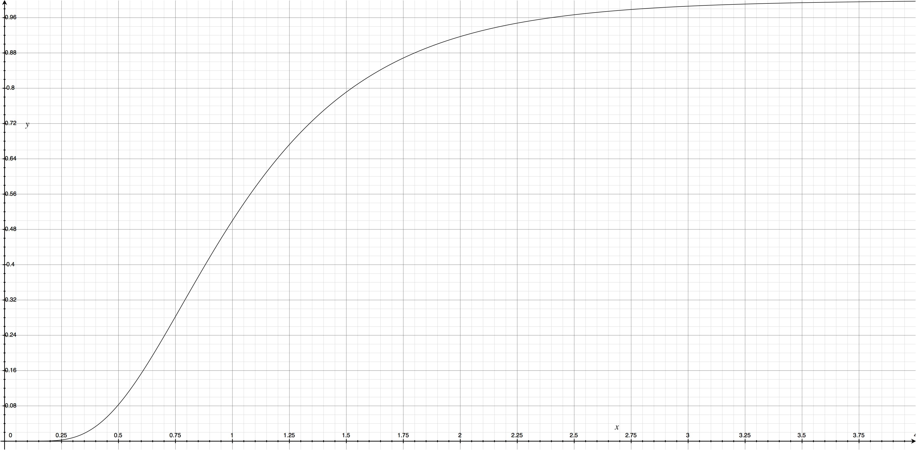
Cumulative Completion Likelihood
Notes:
Cumulative distribution function
Sigmoid curve

Slide 69
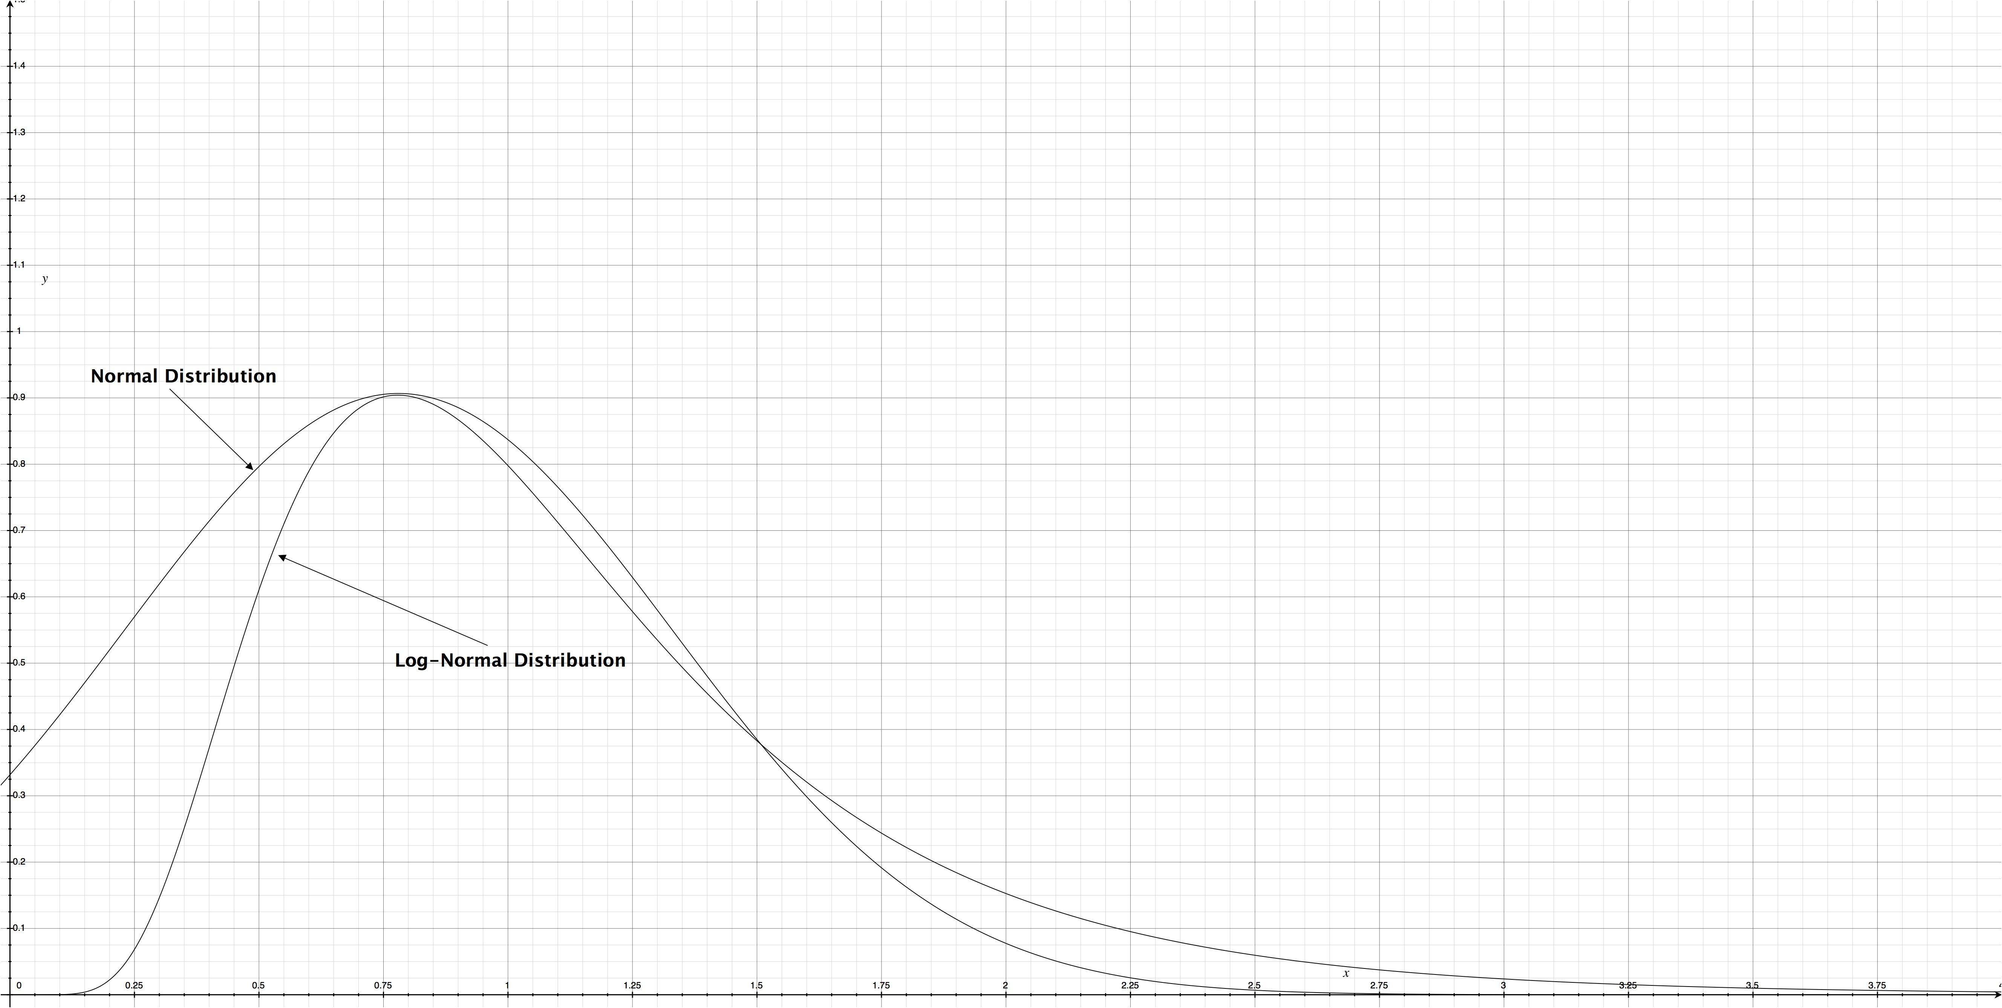
Practically Speaking …
Notes:
We generally don’t care about (or we celebrate!) early completion
Theoretically asymptotic = cut our losses!
For most purposes, a shifted normal distribution is sufficient
Investigating whether application of log-normal and geometric mean provides better models
Notice these are non-linear but humans tend to think and extrapolate linearly

Slide 70
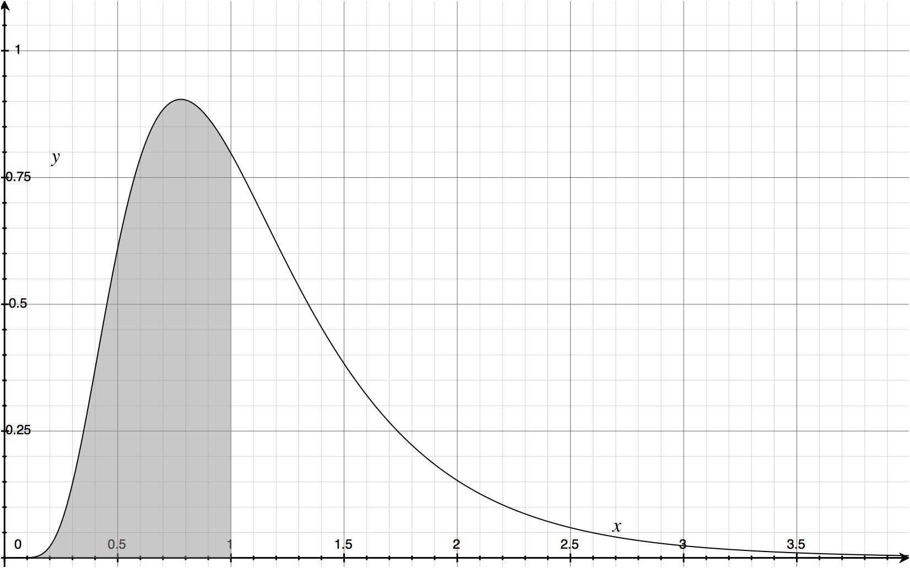
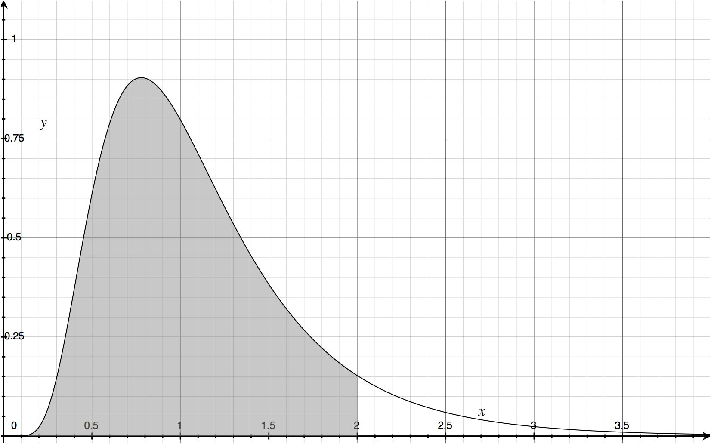
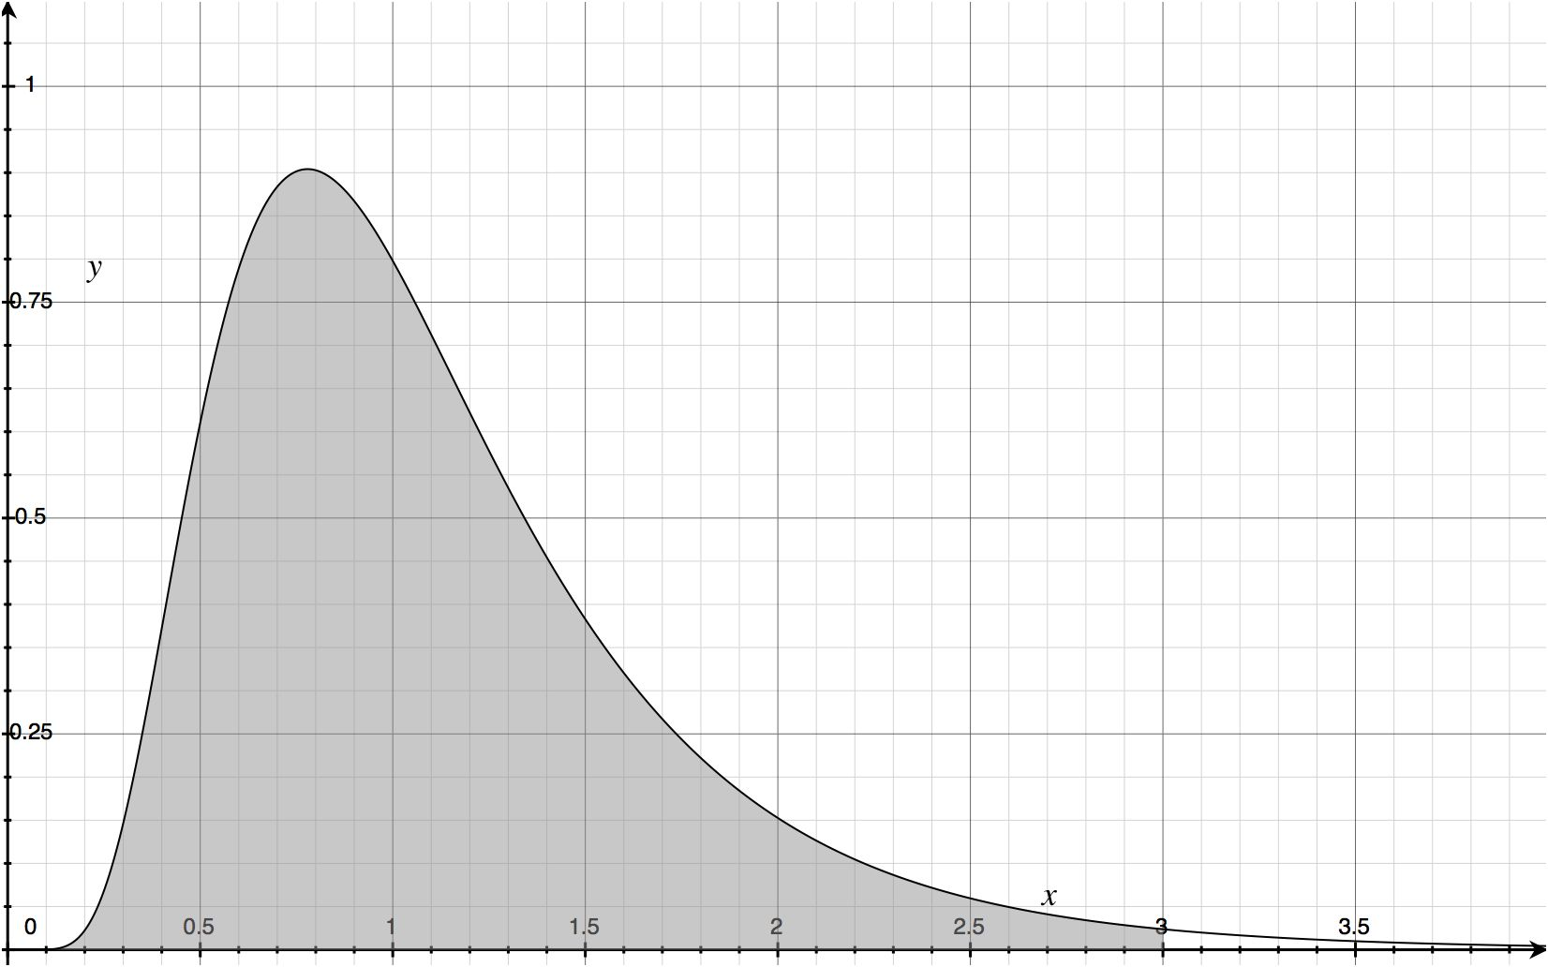
Management Multipliers
1X 50%
2X 91.7%
3X 98.6%
Notes:
Correlation between management 2-3X fudge factors and 80-90% likelihoods of completion
But goldfish grow to fill the tank!

Slide 71
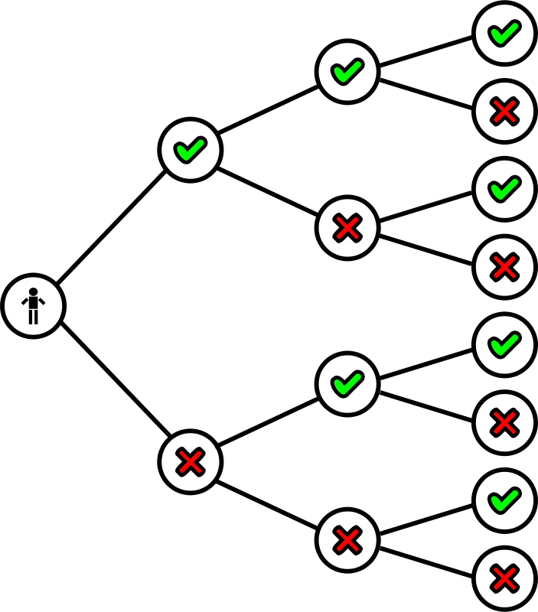
Predictions As Probabilities
You can never give absolute commitments
Sometimes you
Succeed
Fail
Work more hours
Add more people
Trim the scope
Cut corners
Consciously choose and communicate your likelihoods
Notes:
Distribution curves are additive
Distribution likelihoods scale

Slide 72
Cone of Uncertainty
Optimistic
Planned
Pessimistic
Target Scope
Target Date
Scope
Time

Slide 73
Drawing Conclusions
Empirical Estimation

Slide 74
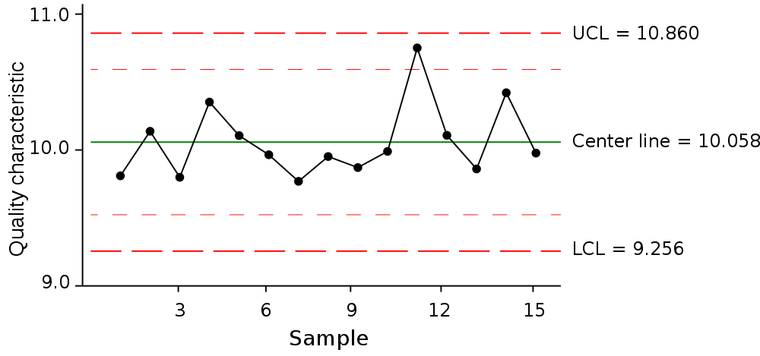
Statistical Process Control Chart
http://upload.wikimedia.org/wikipedia/commons/thumb/f/f7/ControlChart.svg/1000px-ControlChart.svg.png

Slide 75
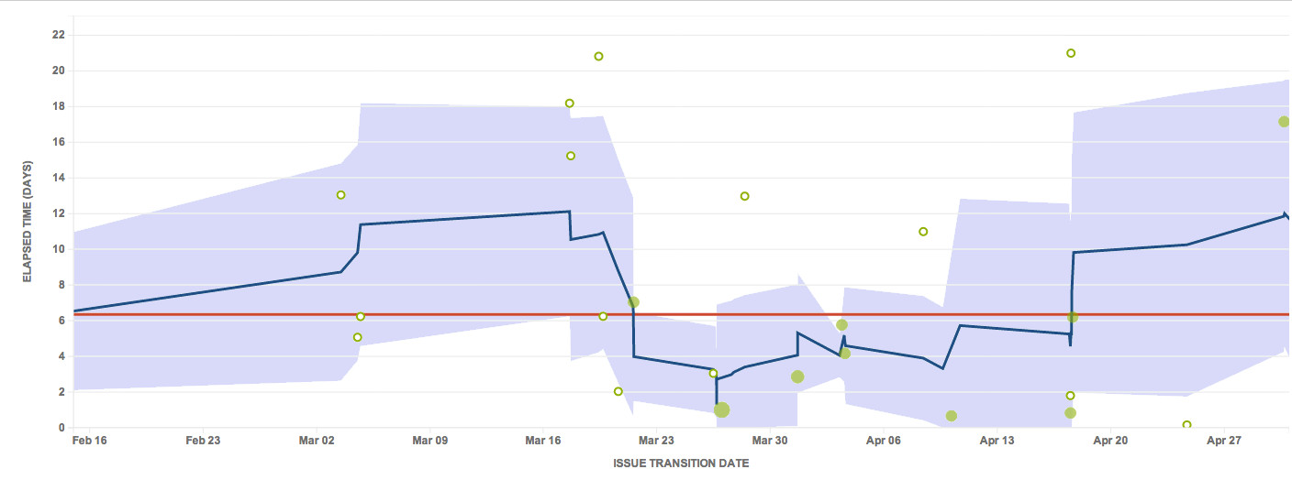
Real SPC Example
Notes:
Applicability of SPC to non-Gaussian normal distributions (and our simplifying assumption)
Interpretation of bands of variation to asymmetric distributions
What does it mean when your variance extends into physically impossible ranges?
“Common” and “special” causes as an aid for process improvement
March 21: Team changed their story slicing approach
April 13: Team hit by the plague

Slide 76
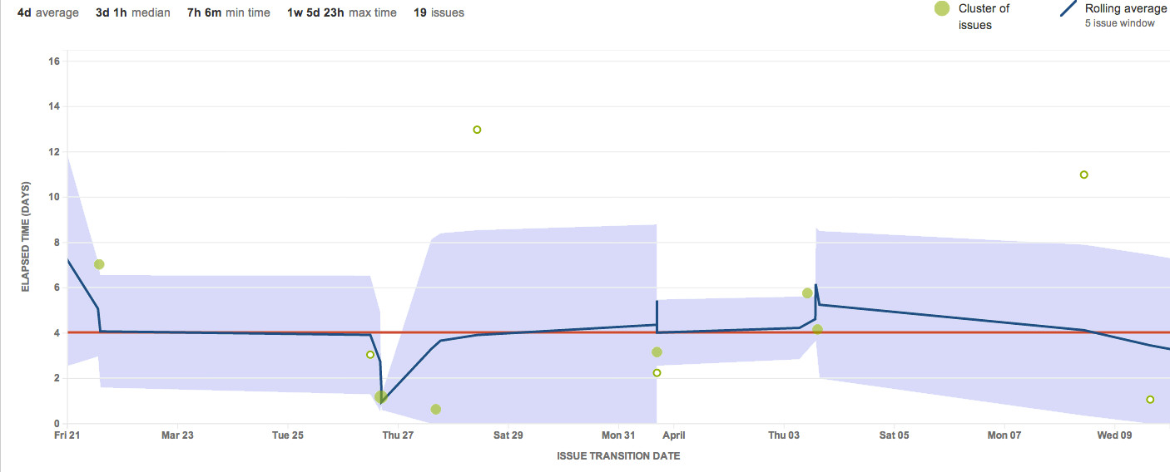
Zooming In

Slide 77
Cycle Time Forecasting
Empirical Estimation

Slide 78
Cycle Time Forecasting
Last updated | 22-Aug-14
 | Issues |  |  |  |  | Duration |  |  | Delivery Forecast
Milestone | Total | Completed | Remaining | WIP | Comments | Optimistic | Average | Pessimistic | Optimistic | Average | Pessimistic
Epic A | 22 | 20 | 2 | 3 | Disconnected end-to-end | 2.00 | 2.83 | 3.67 | 25-Aug-14 | 25-Aug-14 | 26-Aug-14
Epic B | 4 | 3 | 1 | 1 | Integration | 3.00 | 4.25 | 5.50 | 26-Aug-14 | 27-Aug-14 | 28-Aug-14
 | 2 | 2 | 0 | 2 | Admin support | 0.00 | 0.00 | 0.00 | Completed | Completed | Completed
Epic C | 3 | 2 | 1 | 2 | Creation and modify | 1.50 | 2.13 | 2.75 | 25-Aug-14 | 26-Aug-14 | 26-Aug-14
Epic D | 22 | 22 | 0 | 2 |  | 0.00 | 0.00 | 0.00 | Completed | Completed | Completed
Epic E | 7 | 4 | 3 | 1 |  | 9.00 | 12.75 | 16.50 | 5-Sep-14 | 10-Sep-14 | 16-Sep-14
Epic F | 2 | 1 | 1 | 1 | Modify enhancements | 3.00 | 4.25 | 5.50 | 27-Aug-14 | 28-Aug-14 | 29-Aug-14
 |  |  |  |  |  |  |  | Critical Path | 26-Aug-14 | 27-Aug-14 | 28-Aug-14
 |  |  |  |  |  |  |  | Desired Availability | 8-Sep-14
 |  |  |  |  |  |  |  | Release Date | 2-Sep-14
 |  |  |  |  |  |  |  | Release Lock | 29-Aug-14
 |  |  |  |  |  |  |  | Margin (days) | 3 | 2 | 1
 |  |  |  |  |  |  |  | Delivery likelihood | 100%

Slide 79
Bayesian Inference
Empirical Estimation

Slide 80
Bayesian Inference
Combines observations with hypothesis to produce “reasonable” predictions
Results then become observations in future rounds
Results can also change the hypothesis
The “updating function” is key

Slide 81
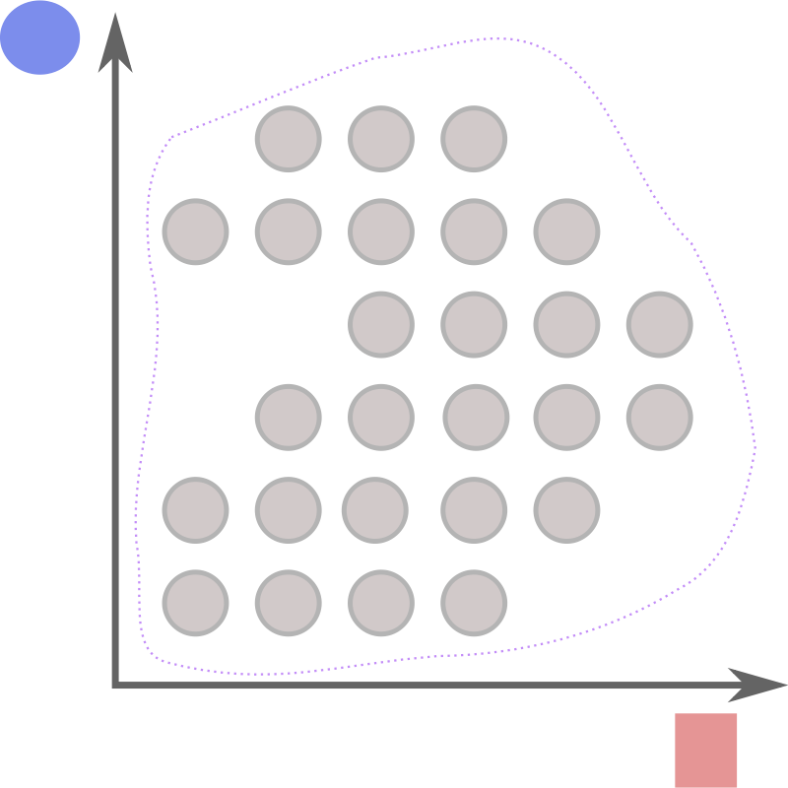
Monte Carlo Simulation
Define a domain of possible inputs
Generate inputs randomly from a probability distribution over the domain
Perform a computation on the inputs
Combine the results

Slide 82
Application to Forecasting
Inputs are cycle times
Probability distribution is random sampling
Deterministic computation can be
Summing divided by expected WIP
Summing over arrival and departure based on expected number (WIP) of processing streams
Time-based progress based on fractional throughput
Aggregation samples from resulting distribution of parallel simulations at desired confidence intervals

Slide 83
Monte Carlo Laboratory
https://github.com/srvance/AgileEstimation

Slide 84
Subjectivity In Estimation
Empirical Estimation

Slide 85
Subjectivity In Forecasting
Forecasts are not reality
Forecasts are based on assumptions
What are our assumptions?

Slide 86
Assumptions Discussion
Do deadlines guarantee results?
Do opinion estimates match real delivery?
Should we filter our inputs?
How do we evaluate cycle time consistency?
Is “yesterday’s weather” valid?
Consistent staffing
Consistent pace
Opinions remain applicable
Cycle times remain consistent
Sampling interval
Averaging interval

Slide 87
Contact Me
steve@vance.com
@StephenRVance
http://www.vance.com
LinkedIn: srvance
GitHub: srvance

